Slide 1
Vanilla LSTM
林亦盛

Slide 2
Outline
RNN
Vanilla LSTM

Slide 3
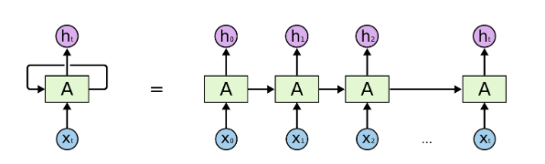
RNN
Vanishing (Exploding) gradient problem

Slide 4
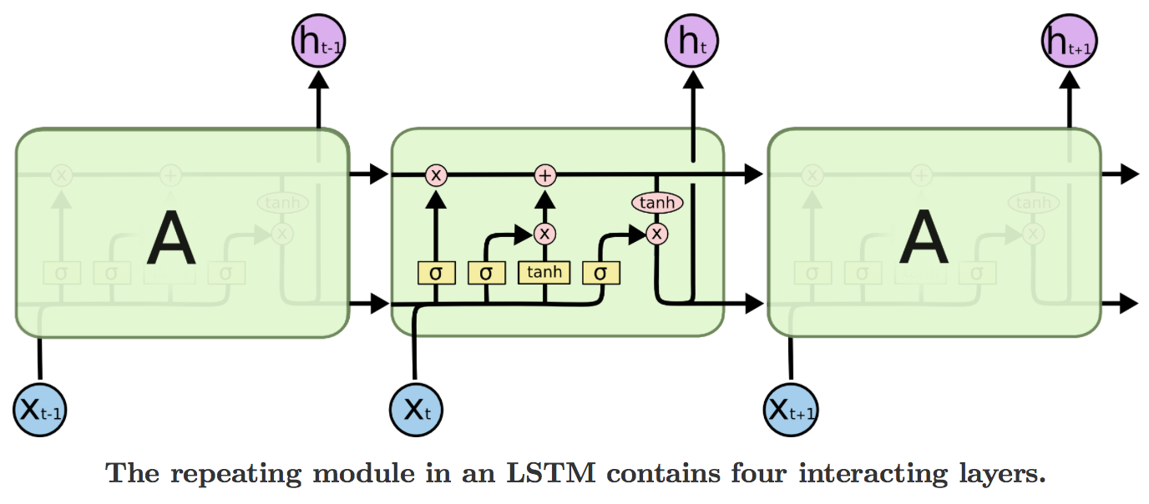
LSTM

Slide 5
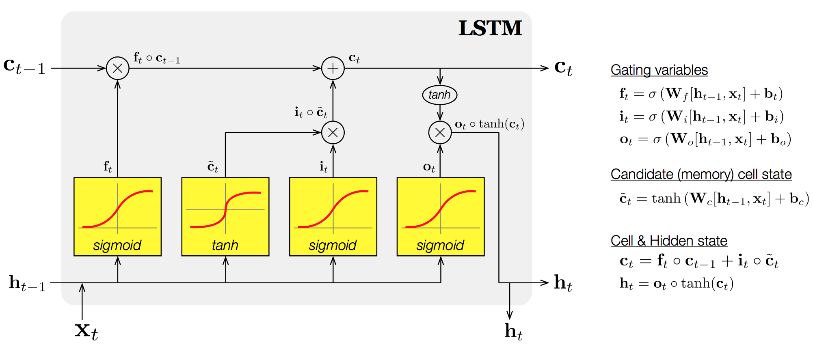
LSTM

Slide 6
參考資料
http://www.jianshu.com/p/f3bde26febed
http://dataunion.org/20778.html
https://www.youtube.com/watch?v=Vdg5zlZAXnU
https://www.youtube.com/watch?v=9zhrxE5PQgY

